Slide 1
Decision Making in Python
By Muhammad Umer

Slide 2
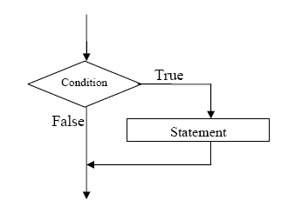
Decision Making in Programming
Decision making in programming is done in terms of testing an expression (logical or relational). The result of the test is either TRUE or FALSE.
A TRUE leads to the execution of a specified piece of code, whereas a FALSE leads to two possibilities; either a piece of code is executed that is different from the TRUE case or a branch takes place.
An important note regarding decision making structures is that they are not loops; they are executed only once.

Slide 3
Operators used in Decision Making
Arithmetic operators are incapable of generating TRUE or FALSE. For this we need operators that can result in YES and NO. In other words operators that can produce Boolean output.
YES | TRUE | 1
NO | FALSE | 0
There are three such operators in Python
Relational Operators OR Comparison Operators
Logical Operators
Membership Operators

Slide 4
Relational Operators
These operators check for equality or describe relative magnitude
< | Less than
> | Greater than
<= | Less than or equal to
>= | Greater than or equal to
== | Double equal to
!= | Is not equal to
All these operators ask question about the equality or inequality of the given data. The answer is YES(1) or NO(0)
Recommendation: Compare similar data-types (e.g. int with int ). Dissimilar data-type comparison may lead to errors.

Slide 5
Logical Operators
Basic logical operations are: AND OR NOT
Operators | Keyword in Python
AND | and
OR | or
NOT | not

Slide 6
AND Operator
It returns TRUE if both the operands (right side and left side) are true
Inp A | Inp B | Output
False(0) | False(0) | False(0)
False(0) | True(1) | False(0)
True(1) | False(0) | False(0)
True(1) | True(1) | True(1)

Slide 7
OR Operator
It returns TRUE if either of the operand (right side or left side) is true
Inp A | Inp B | Output
False(0) | False(0) | False(0)
False(0) | True(1) | True(1)
True(1) | False(0) | True(1)
True(1) | True(1) | True(1)

Slide 8
NOT Operator
It simply negates the input
Input | Output
True(1) | False(0)
False(0) | True(1)

Slide 9
Membership Operator
These operators test for membership in a sequence such as lists, strings or tuples.
There are two membership operators that are used in Python. (in, not in).
It gives the result based on the variable present in specified sequence or string

Slide 10
The if Statement
Syntax :
If test condition :
Block of code that has to be executed if condition is true
This Indented block is called the body of if statement

Slide 11
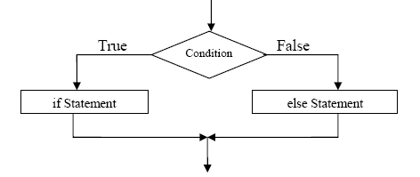
The if-else statement
Syntax :
If test condition :
Block of code that has to be executed if condition is true
➔ The if()-else statement is similar to the if() statement with the only difference being the ability to cater for the case when test fails
else :
Block of code that has to be executed if condition is false

